Slide 1
Dynamic Workload Deployments
Azure Bootcamp 2016
Presented on: 04/16/2016

Slide 2
What to Expect
The Agenda
Deploying IaaS Applications as Code
Review Azure Resource Manager
Review Document Templates (JSON)
Download and Walk Through Demo of Deployment
Walk Through Document Modifications
Lunch
Azure Hybrid Cloud Talk
Deploying PaaS Applications as Code
Deploy IaaS Document Website (Desired State Config)
Review Azure PaaS Offerings
Review Tools – Visual Studio
Download and Walk Through Code
Demo Deployment of the PaaS Website

Slide 3
What You’ll Need
Some Requirements
Microsoft Azure Subscription
A Windows Laptop or VM With:
Visual Studio Community
Azure SDK and Tools for VS
PowerShell Tools for VS
SQL Server Data Tools

Slide 4
How This Will Work
Document Template (Quickstart Template)
High level explanation of JSON
Document Templates and Deployment
Desired State Configuration (DSC)
IaaS and PaaS (What’s the difference?)
Deploy a website into a PaaS web app

Slide 5
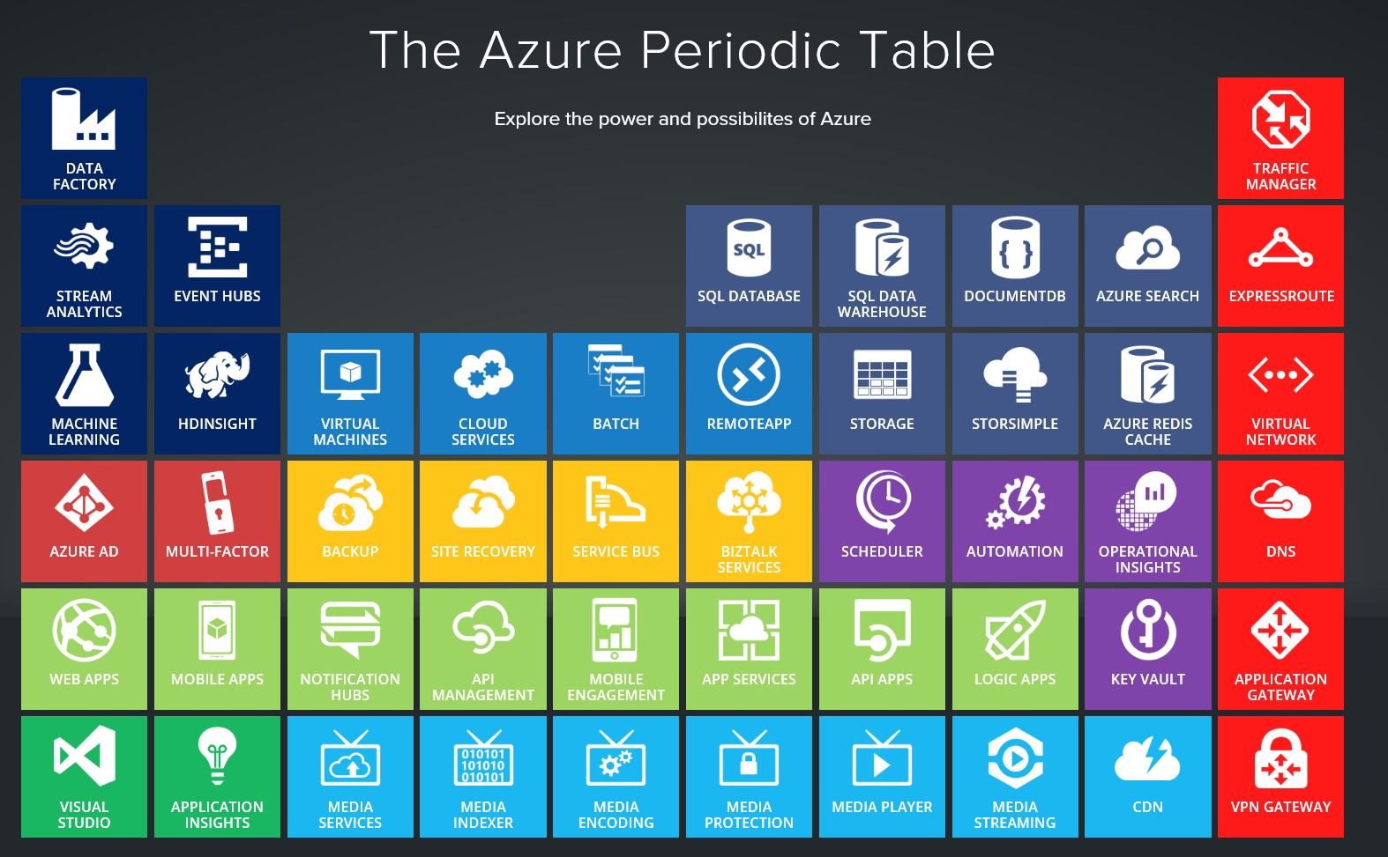

Slide 6
Azure Resource Manager

Slide 7
Have you heard of ARM?

Slide 8
Lend Me an ARM
What is Azure Resource Manager & Why Use It
Azure Resource Manager
A logical grouping of virtual Azure resources used for deployment, management, and access control of those resources.
All Azure services and components must be contained in a Resource Group
Security
Resource Groups and Azure AD integration allow for robust access controls
Deployment
Azure Document Templates allow for Infrastructure as Code deployments of all Azure resource types
Notes:
Manage, access, view, as a single set
Billing rollup
Allows administrator to control provisioning resources prepared by a pre-baked template

Slide 9
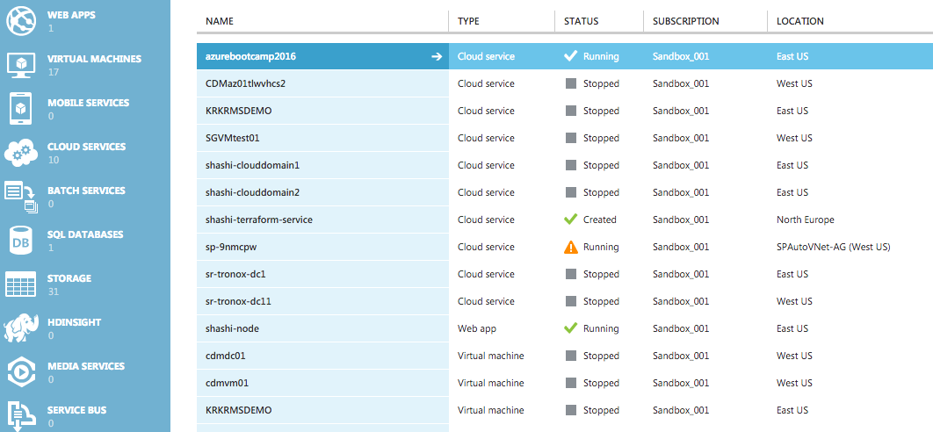
ARM vs ASM
Azure Resource Manager vs Azure Service Manager
r
Azure Service Manager
Cloud Service Based
Limited Control of Access
Limited Customization of Resources
Complex Deployment Methodology
Azure Resource Manager
Group Based
Robust Resource Customization
Robust RBAC (Resource Based Access Control) Model
Fundamentally Infrastructure as Code (https://resources.azure.com)

Slide 10
ARM vs ASM
Some Advantages
You can deploy, manage, and monitor all of the resources for your solution as a group, rather than handling these resources individually.
You can repeatedly deploy your solution throughout the development lifecycle and have confidence your resources are deployed in a consistent state.
You can use declarative templates to define your deployment.
You can define the dependencies between resources so they are deployed in the correct order.
You can apply access control to all services in your resource group because Role-Based Access Control (RBAC) is natively integrated into the management platform.
You can apply tags to resources to logically organize all of the resources in your subscription.
You can clarify billing for your organization by viewing the rolled-up costs for the entire group or for a group of resources sharing the same tag.
From https://azure.microsoft.com/en-us/documentation/articles/resource-group-overview/

Slide 11
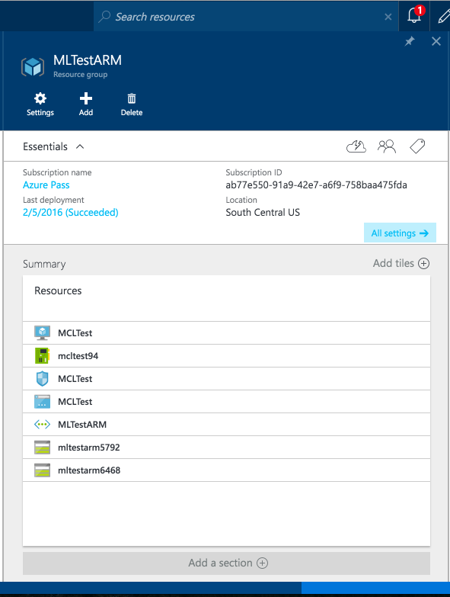
Resource Groups
The Container
Can contain all resources, or a single resource, of an Azure Deployment
Manages Access for the Resources
Can reference, or be dependent on, other resource groups
Can streamline the cleanup process

Slide 12
ARM Architecture
An Example of an Environment

Slide 13
On Document Templates

Slide 14
What is a Document Template
Do you know JSON?
{
“key” : “value”,
{
“key” : “value”,
“key” : “value”
}
}
Watch for Commas!
At the end of every line, except for the last in a group.
Notes:
Java Script Object Notation (JSON)
Schema -
What resources
Where to deploy
Which parameters/values you want to pass

Slide 15
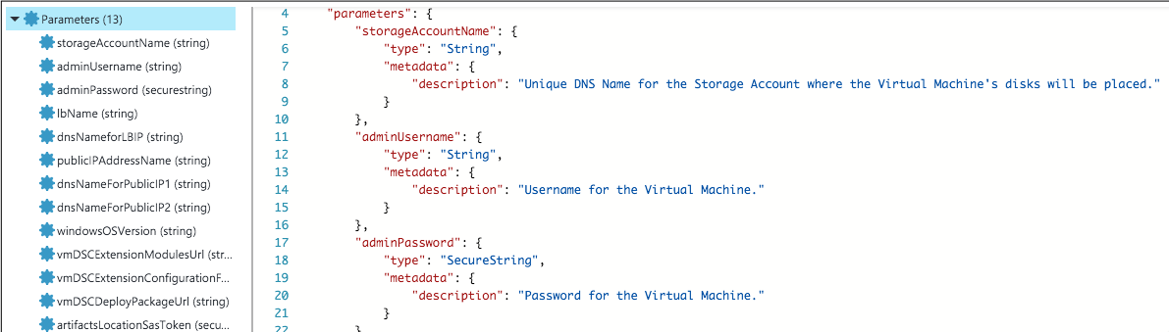
The Anatomy of a Document Template
Variables, Properties, & Resources – Oh My
Parameters
Parameter Header
Parameter Name
Parameter Type
Parameter Description
Notes:
Schema - Location of the JSON schema file that describes the version of the template language
Content – Versioning
Parameters – Values you input to customize deployment

Slide 16
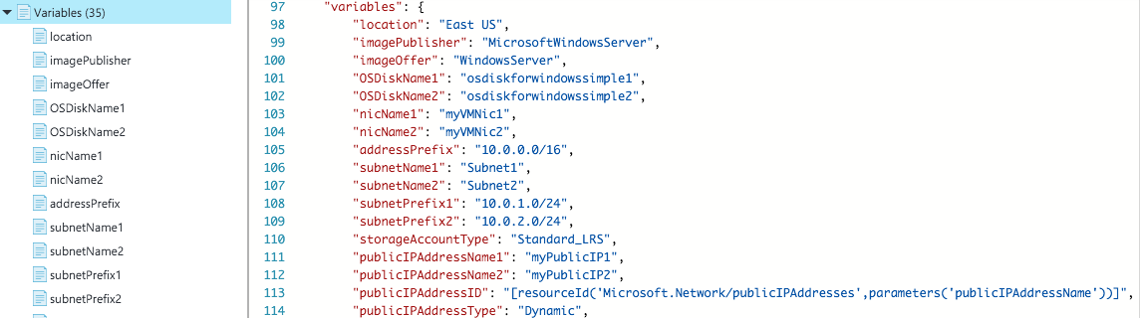
The Anatomy of a Document Template
Variables, Properties, & Resources – Oh My
Variables
Variable Header
Variable Name
Variable Value

Slide 17
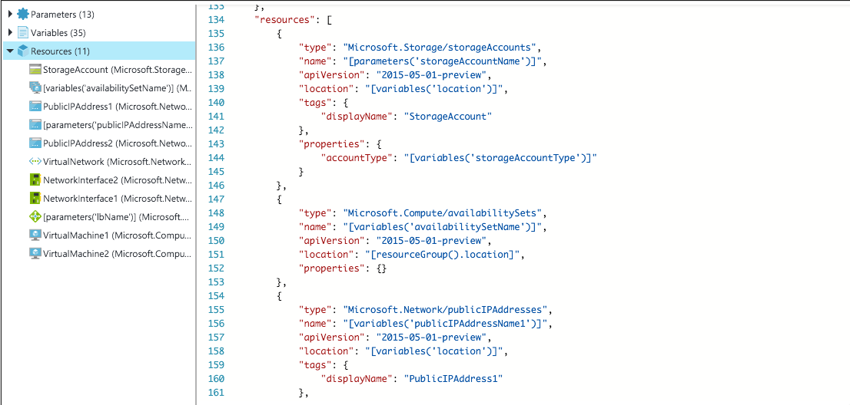
The Anatomy of a Document Template
Variables, Properties, & Resources – Oh My
Resources
Parameter Ref.
Resource Header
Resource Properties
Variable Ref.
Special Function

Slide 18
Deploying a Document Template
Through the Portal & Beyond
Through Visual Studio
Through PowerShell
Through the Portal

Slide 19
Other Resources
Continue Learning
Documentation
https://azure.microsoft.com/en-us/documentation/articles/
Channel 9 – Microsoft Video Network
https://channel9.msdn.com/
Azure Resource Explorer (beta)
https://resources.azure.com

Slide 20
Let’s Get to Building [IaaS]

Slide 21
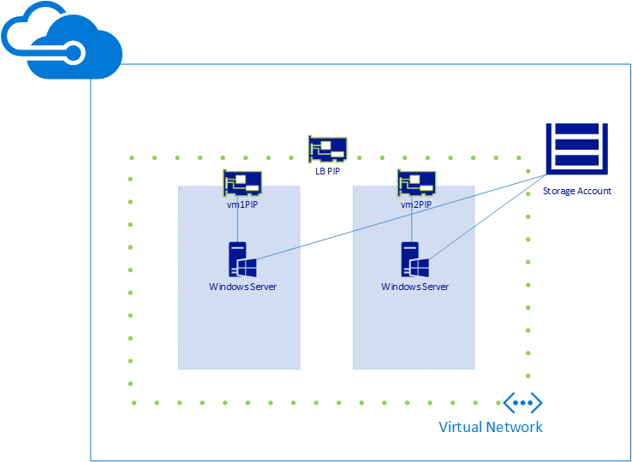
What are we building?

Slide 22
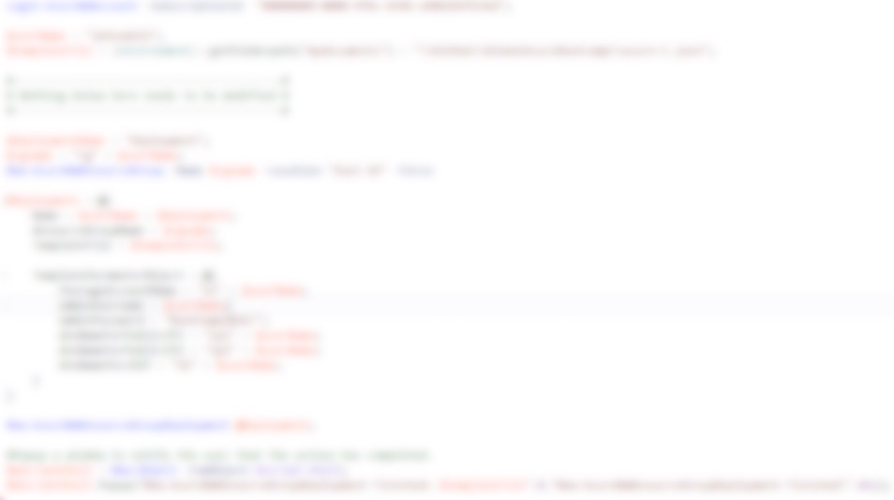
First things first
Get the Code
https://github.com/NimboCloud/GlobalAzureBootcamp
Open Project Deployment.sln
Change 3 lines of code
Notes:
Download the zip from the Git Link
After extraction open Deployment.SLN
Modify top three sections

Slide 23
Step One
Lay down your foundation
azure-A.json
Define Resource Group
Build Azure vNet
Defined via CIDR block
Build Azure Subnets

Slide 24
Step Two
Add Storage & Connectivity
azure-B.json
Create Storage Account
Build Networking
Load Balancer
NICs

Slide 25
Step Three
Build VMs
azure-C.json
Deploy Virtual Machines
Connect

Slide 26
Time for a Break

